Slide 1
Instructor: Amit Kumar Das
Lecture 8
Lecturer,
Department of Computer Science & Engineering,
East West University
Dhaka, Bangladesh.

Slide 2
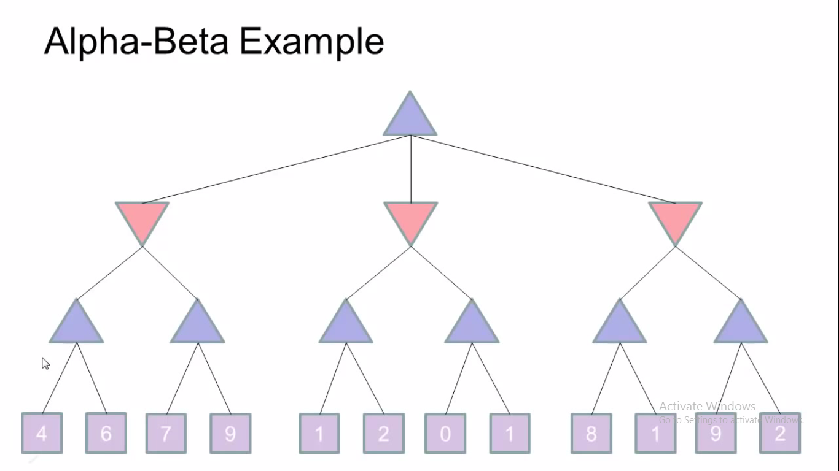

Slide 3
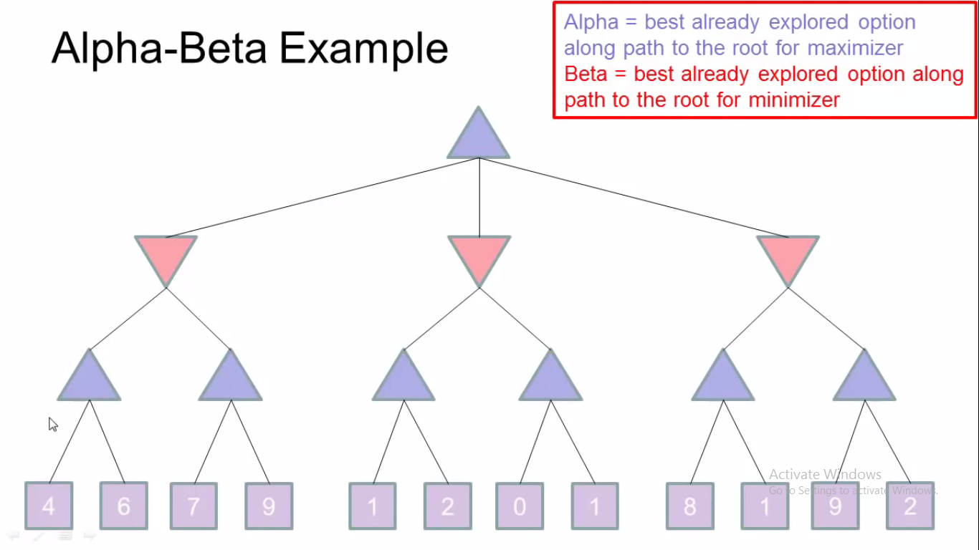

Slide 4
A Simple Truth
“The Gene is by far the most sophisticated program around.”
- Bill Gates, Business Week, June 27, 1994

Slide 5
Genetic Algorithm
To understand the adaptive processes of natural systems
To design artificial systems software that retains the robustness of natural systems
Provide efficient, effective techniques for optimization and machine learning applications

Slide 6
Main Idea
Take a population of candidate solutions to a given problem.
Use operators inspired by the mechanisms of natural genetic variation.
Apply selective pressure toward certain properties
Evolve a more fit solution

Slide 7
GA Terminology
Abstractions imported from biology
Chromosomes, Genes, Alleles
Fitness, Selection
Crossover, Mutation

Slide 8
GA Terminology
In the spirit – but not the letter – of biology
GA chromosomes are strings of genes
Each gene has a number of alleles; i.e., settings
Each chromosome is an encoding of a solution to a problem
A population of such chromosomes is operated on by a GA

Slide 9
Encoding
A data structure for representing candidate solutions
Often takes the form of a bit string
Usually has internal structure; i.e., different parts of the string represent different aspects of the solution.

Slide 10
Crossover
Mimics biological recombination
Some portion of genetic material is swapped between chromosomes
Typically the swapping produces an offspring
Mechanism for the dissemination of “building blocks” (schemas)

Slide 11
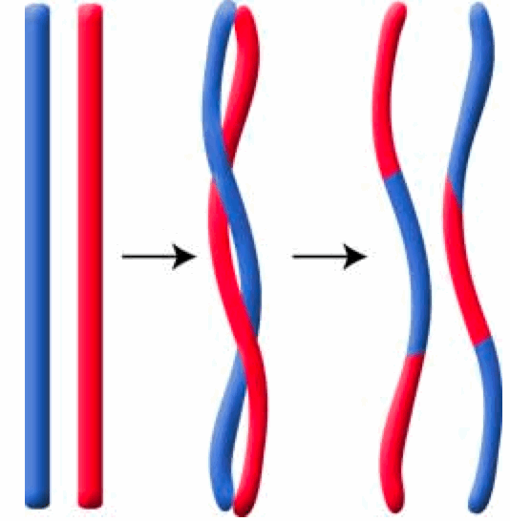
Crossover

Slide 12
Mutation
Selects a random locus – gene location – with some probability and alters the allele at that locus
The intuitive mechanism for the preservation of variety in the population

Slide 13
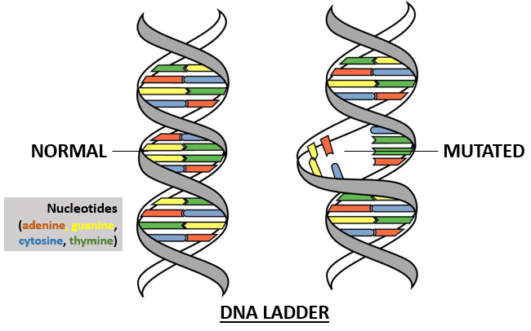
Mutation

Slide 14
Fitness
A measure of the goodness of the organism
Expressed as the probability that the organism will live another cycle (generation)
Basis for the natural selection simulation
Organisms are selected to mate with probabilities proportional to their fitness
Probabilistically better solutions have a better chance of conferring their building blocks to the next generation (cycle)

Slide 15
The GA cycle
children
reproduction
modification
modified
children
parents
population
evaluation
evaluated children
deleted
members
discard

Slide 16
The GA cycle
Randomly generated initial
population
Evaluate
All
individual
Stop ?
Best
individual
Y
N
Start
Crossing Over
Result
Generation Cycle
Mutation

Slide 17
Population
population
Chromosomes could be:
Bit strings (0101 ... 1100)
Real numbers (43.2 -33.1 ... 0.0 89.2)
Permutations of element (E11 E3 E7 ... E1 E15)
Lists of rules (R1 R2 R3 ... R22 R23)
Program elements (genetic programming)
... any data structure ...

Slide 18
Reproduction
children
reproduction
parents
population
Parents are selected at random with selection chances biased in relation to chromosome evaluations.

Slide 19
Modification
Modifications are stochastically triggered
Operator types are:
Mutation
Crossover (recombination)
children
modification
modified children

Slide 20
Evaluation
The evaluator decodes a chromosome and assigns it a fitness measure
The evaluator is the only link between a classical GA and the problem it is solving
modified
children
evaluated
children
evaluation

Slide 21
Deletion
population
Generational GA: entire populations replaced with each iteration
Steady-state GA: a few members replaced at each generation
discarded members
discard

Slide 22
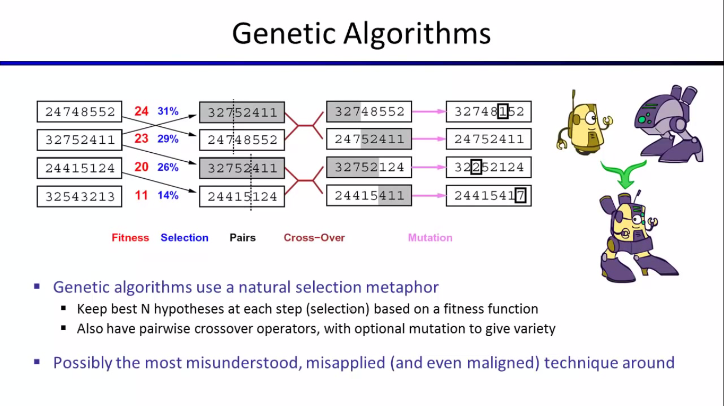

Slide 23
Example: the MAXONE problem
Suppose we want to maximize the number of ones in a string of l binary digits.

Slide 24
Example (cont)
An individual is encoded (naturally) as a string of l binary digits
The fitness f of a candidate solution to the MAXONE problem is the number of ones in its genetic code
We start with a population of n random strings. Suppose that l = 10 and n = 6

Slide 25
Example (initialization)
We toss a fair coin 60 times and get the following initial population:
S₁ | = | 1 | 1 | 1 | 1 | 0 | 1 | 0 | 1 | 0 | 1 | f(S₁ ) | = | 7
S₂ | = | 0 | 1 | 1 | 1 | 0 | 0 | 0 | 1 | 0 | 1 | f(S₂ ) | = | 5
S₃ | = | 1 | 1 | 1 | 0 | 1 | 1 | 0 | 1 | 0 | 1 | f(S₃ ) | = | 7
S₄ | = | 0 | 1 | 0 | 0 | 0 | 1 | 0 | 0 | 1 | 1 | f(S₄ ) | = | 4
S₅ | = | 1 | 1 | 1 | 0 | 1 | 1 | 1 | 1 | 0 | 1 | f(S₅ ) | = | 8
S₆ | = | 0 | 1 | 0 | 0 | 1 | 1 | 0 | 0 | 0 | 0 | f(S₆ ) | = | 3
Fitness |  |  |  |  |  |  |  |  |  |  |  |  | = | 34

Slide 26
Example (selection)
Suppose that, after performing selection, we get the following population:
S₁’ | = | 1 | 1 | 1 | 1 | 0 | 1 | 0 | 1 | 0 | 1 | (S₁ ) | = | 7
S₂’ | = | 1 | 1 | 1 | 0 | 1 | 1 | 0 | 1 | 0 | 1 | (S₃ ) | = | 7
S₃’ | = | 1 | 1 | 1 | 0 | 1 | 1 | 1 | 1 | 0 | 1 | (S₅ ) | = | 8
S₄’ | = | 0 | 1 | 1 | 1 | 0 | 0 | 0 | 1 | 0 | 1 | (S₂ ) | = | 5
S₅’ | = | 0 | 1 | 0 | 0 | 0 | 1 | 0 | 0 | 1 | 1 | (S₄ ) | = | 4
S₆’ | = | 0 | 1 | 0 | 0 | 1 | 1 | 0 | 0 | 0 | 0 | (S₆ ) | = | 3
Fitness |  |  |  |  |  |  |  |  |  |  |  |  | = | 34

Slide 27
Example (crossover1)
Next we mate strings for crossover. For each couple we decide according to crossover probability (for instance 0.6) whether to actually perform crossover or not
Suppose that we decide to actually perform crossover only for couples (s₁`, s₂`) and (s₅`, s₆`). For each couple, we randomly extract a crossover point, for instance 2 for the first and 5 for the second.

Slide 28
Example (crossover2)
Before crossover
S₁’ | = | 1 | 1 | 1 | 1 | 0 | 1 | 0 | 1 | 0 | 1
S₂’ | = | 1 | 1 | 1 | 0 | 1 | 1 | 0 | 1 | 0 | 1
S₅’ | = | 0 | 1 | 0 | 0 | 0 | 1 | 0 | 0 | 1 | 1
S₆’ | = | 0 | 1 | 0 | 0 | 1 | 1 | 0 | 0 | 0 | 0
After crossover
S₁’’ | = | 1 | 1 | 1 | 0 | 1 | 1 | 0 | 1 | 0 | 1
S₂’’ | = | 1 | 1 | 1 | 1 | 0 | 1 | 0 | 1 | 0 | 1
S₅’’ | = | 0 | 1 | 0 | 0 | 0 | 1 | 0 | 0 | 0 | 0
S₆’’ | = | 0 | 1 | 0 | 0 | 1 | 1 | 0 | 0 | 1 | 1

Slide 29
Example (mutation1)
The final step is to apply random mutation: for each bit that we are to copy to the new population we allow a small probability of error (for instance 0.1)
Before applying mutation:
S₁’’ | = | 1 | 1 | 1 | 0 | 1 | 1 | 0 | 1 | 0 | 1
S₂’’ | = | 1 | 1 | 1 | 1 | 0 | 1 | 0 | 1 | 0 | 1
S₃’’ | = | 1 | 1 | 1 | 0 | 1 | 1 | 1 | 1 | 0 | 1
S₄’’ | = | 0 | 1 | 1 | 1 | 0 | 0 | 0 | 1 | 0 | 1
S₅’’ | = | 0 | 1 | 0 | 0 | 0 | 1 | 0 | 0 | 0 | 0
S₆’’ | = | 0 | 1 | 0 | 0 | 1 | 1 | 0 | 0 | 1 | 1

Slide 30
Example (mutation2)
After applying mutation:
S₁’’’ | = | 1 | 1 | 1 | 0 | 1 | 1 | 1 | 1 | 0 | 1 | f(S₁’’’) | = | 8
S₂’’’ | = | 1 | 1 | 1 | 1 | 1 | 1 | 0 | 1 | 0 | 0 | f(S₂’’’) | = | 7
S₃’’’ | = | 1 | 1 | 1 | 0 | 1 | 1 | 1 | 1 | 1 | 1 | f(S₃’’’) | = | 9
S₄’’’ | = | 0 | 1 | 1 | 1 | 0 | 0 | 0 | 1 | 0 | 1 | f(S₄’’’) | = | 5
S₅’’’ | = | 0 | 1 | 0 | 0 | 0 | 1 | 0 | 0 | 0 | 1 | f(S₅’’’) | = | 3
S₆’’’ | = | 0 | 1 | 0 | 0 | 1 | 1 | 0 | 1 | 1 | 1 | F(S₆’’’) | = | 5
Fitness |  |  |  |  |  |  |  |  |  |  |  |  | = | 37

Slide 31
Example (end)
In one generation, the total population fitness changed from 34 to 37, thus improved by ~9%
At this point, we go through the same process all over again, until a stopping criterion is met

Slide 32
Thank You

